Slide 1
Data-driven Social Science Gastone Riccardo Tolli ID: 33506151
IS71061A: Data Science Final Project
Date: 05/10/2018

Slide 2
Introduction
Describing problems with social science research
Explore the ways it can be improved
Providing six first-hand examples
Social science is intended as the counterpart of physical science.

Slide 3
Problems
The statistics used in social science research is generally simplistic , focus on linear, logistic regression and p-,t- and F- values testing
Editors pressure to keep the statistical techniques simple
The result is descriptive “post-dictive” knowledge rather than explanatory predictive knowledge too many false positives replication crisis.
Socio-political decision makers never rely on sociology findings (which used to happen with physical sciences too e.g. old doctors did not know physics or biology).

Slide 4

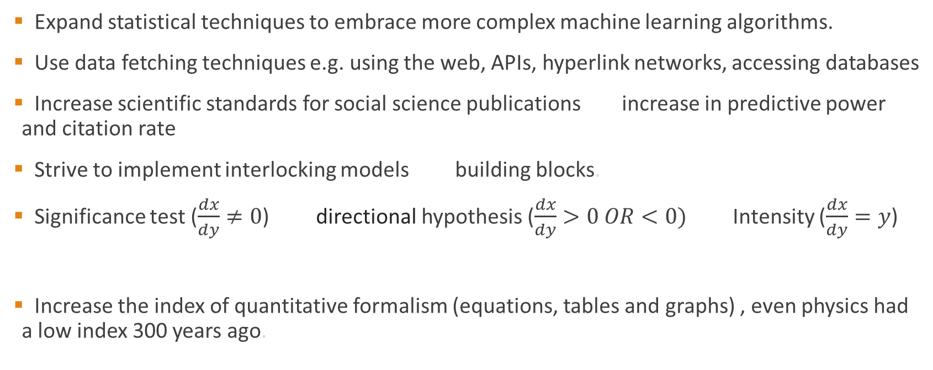
Solutions
Expand statistical techniques to embrace more complex machine learning algorithms.
Use data fetching techniques e.g. using the web, APIs, hyperlink networks, accessing databases
Increase scientific standards for social science publications increase in predictive power and citation rate
Strive to implement interlocking models building blocks.
Significance test ($\frac{dx}{dy}≠0$) directional hypothesis ($\frac{dx}{dy}>0 OR<0)$ Intensity ($\frac{dx}{dy}=y$)
Increase the index of quantitative formalism (equations, tables and graphs) , even physics had a low index 300 years ago.
full function ($y=f(x)$)

Slide 5
Solutions cont`d
Bring social sciences to a best practice approach to the level of business, finance, marketing where research is used for practical scopes
Take advantage of the new data coming from the intense digitalization, internet of things and the digital footprint
Increase in internet speed, mobile devices and increase in processing power have caused incredible amount of data to be available and analyzable

Slide 6
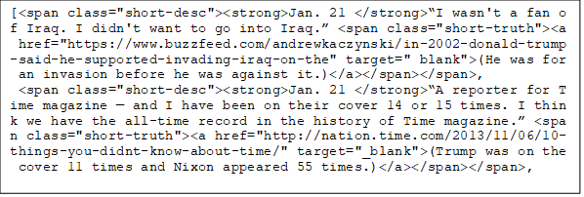
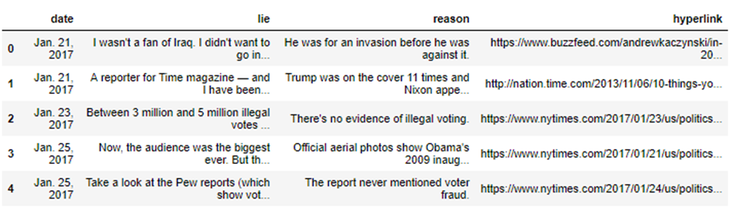
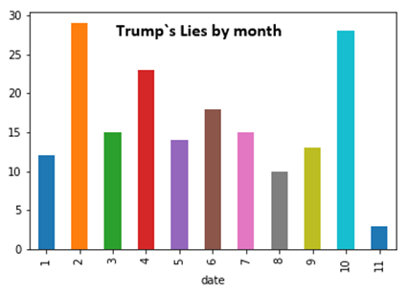
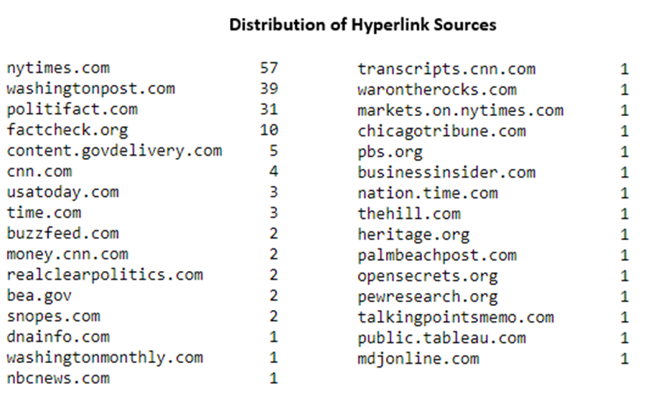
Example 1: Webscraping
Fetching data from a webpage and transform it into tidy data
Using python, BeautifulSoup and html extract the desired data from the webpage code and create a dataset with it

Slide 7
Example 2: Recommender System
Using movie data in R
Descriptive statistics :
Developed a Content Based Filtering : based on usage history of an user, similar items are suggested.
Developed a Collaborative Filtering : clusters users on the basis of their behaviour history and recommends items that a similar user consumed. A word of mouth simulation
Genres Popularity Average Ratings

Slide 8
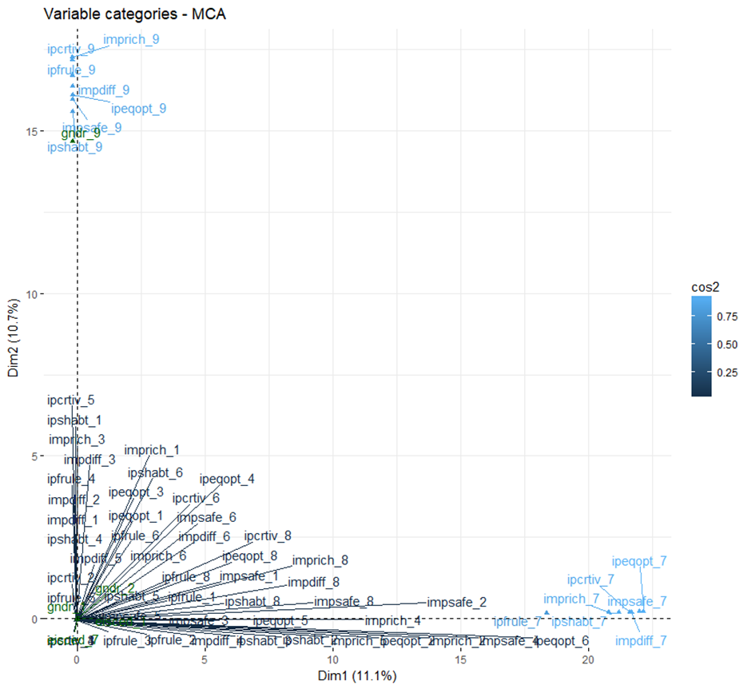
Example 3: Multivariate Analysis
Squared Cosine
Analyze European Social Survey (ESS) round 6 from 2012
Using exploratory analysis and dimensionality reduction to gain insight in a multitude of variables
Apply MCA (Multiple Correspondence Analysis) with a selection of variables there is no dominant dimension that explain a lot of variance
From the Squared Cosine which shows the quality of representation of variable categories on the first 2 axes it is possible to observe that people who did not want to respond to some questions also did not want to respond to other questions.
Understanding why this is happening is a qualitative research task. It may have to do with people`s individual personality and the way the questions are posed.

Slide 9
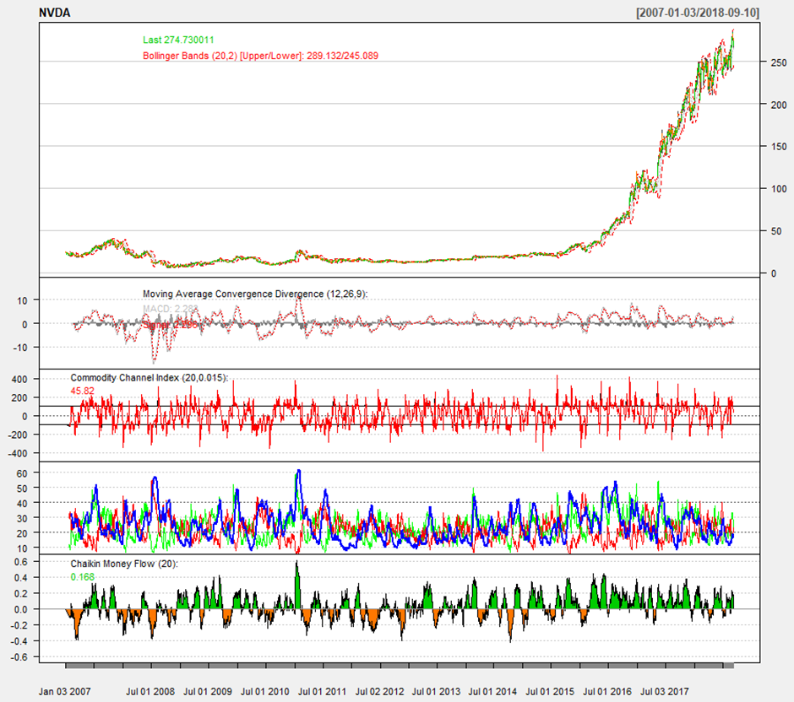
Example 4: Retrieving and analyzing financial data
Using R and quantmod it is possible to retrieve data on trading days of stocks
Retrieve the OHLC (Opening-high-low-close) table for NVIDIA.
Visualize the high price time series with a variety of technical indicators.
Computing the mean log return (1.000854 %) and the standard deviation
Apply a Random Walk

Slide 10
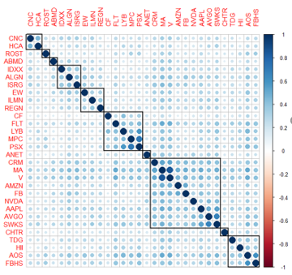
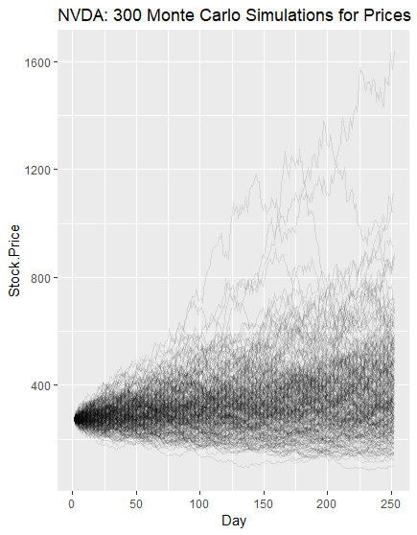
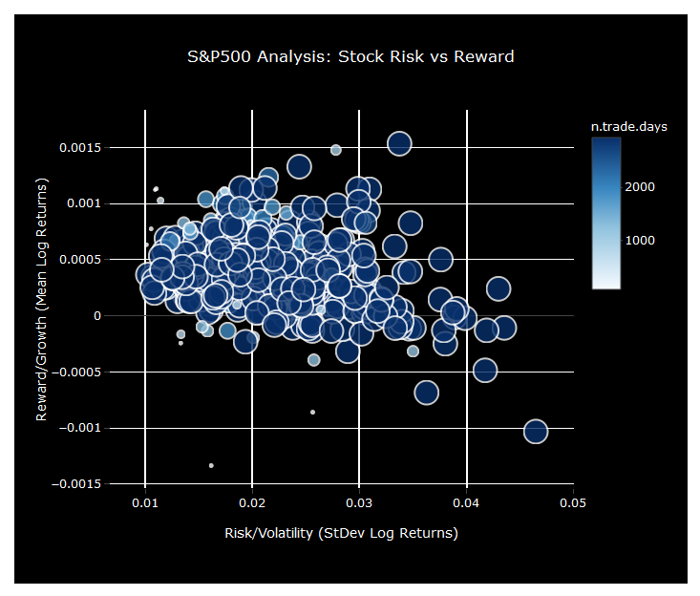
Example 4 cont`d
Use the Random Walk to create a Monte Carlo simulation
S&P500 analysis: scrape companies` basic info from Wikipedia, and the stock info retrieved with quantmod
Creating an interactive scatterplot and correlation table

Slide 11
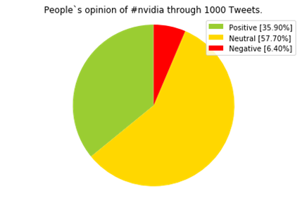
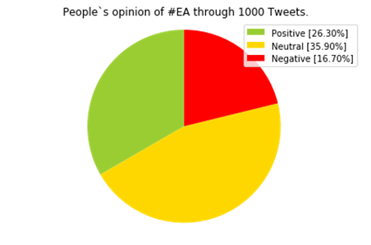
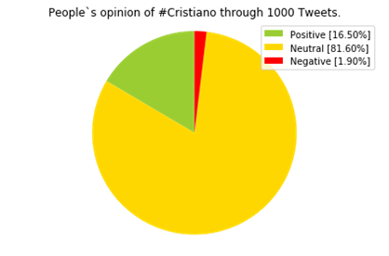
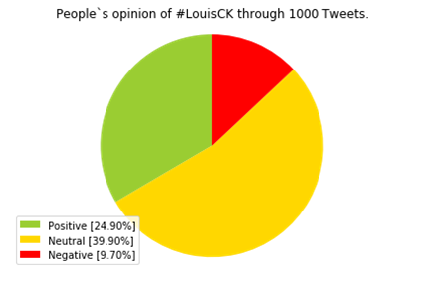
Example 5: Using Twitter API
Tweepy for Python allows access to Twitter`s API so that data can be retrieved and subsequently analyzed
Authenticate the app, retrieve tweets in English about a specific hashtag or keyword
Apply TextBlob for NPL analysis

Slide 12
Example 6: Loan Approval Prediction
Predicting whether to approve a loan to a customer (Dream Housing Finance data)
KNN used to impute missing data
Recursive Feature with crossvalidation used to select the most important variables
Using caret in R, apply GBM, Linear Regression, Random Forest and Neural Network
Optimize the algorithms with tunelength and tunegrid

Slide 13
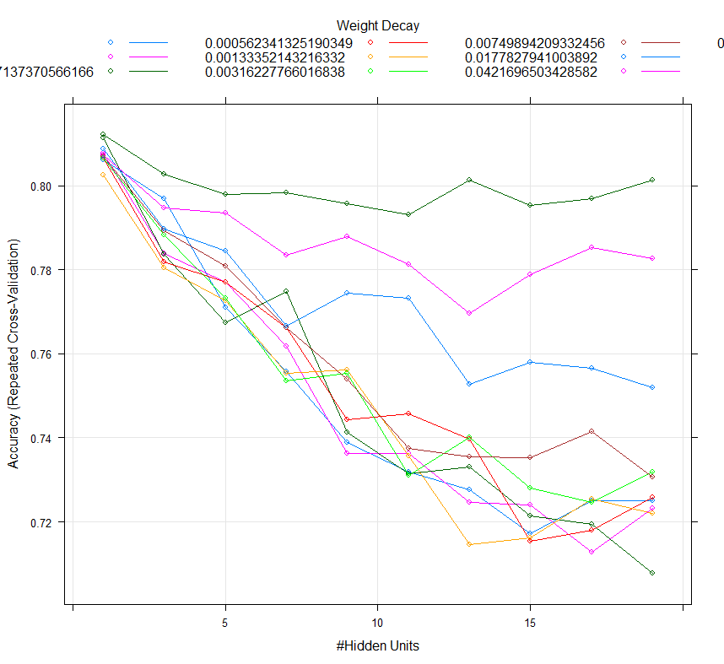
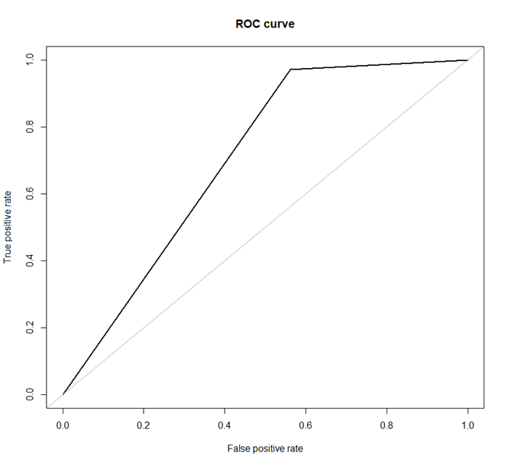
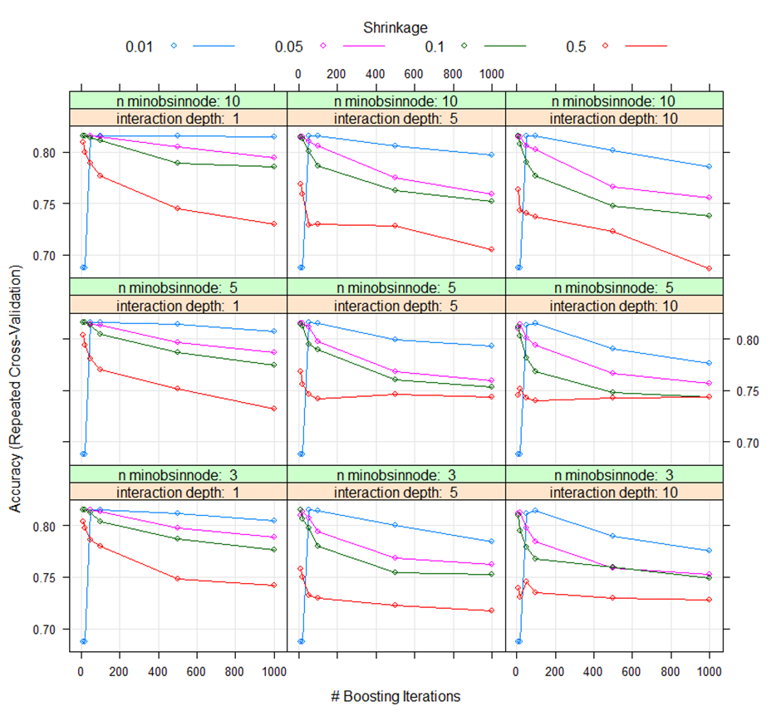
Example 6 cont`d
Performance GBM
Performance Nnet
Confusion Matrix RF
ROC curve RF
Best : n.trees = 500, interaction.depth = 1
shrinkage = 0.01
n.Minobsinnode = 10
Best : size = 1
decay = 0.1
Best: mtry=2
AUC = 0.7045

Slide 14
Final Considerations
Replication problems are found in hard sciences as well, e.g. nutritional and medical
But social science suffers from a “replication crisis”
Shift in practices to focus on the best science available while keep striving for better abandon opinion based social science that cause the low citation rate
Reductionism: everything can be reduced to a simpler more general law everything is a physics phenomenon everything is theoretically predictable with perfect knowledge
Although perfect knowledge is unfeasible with the current means, the role of science is to strive for it relentlessly

